Slide 1
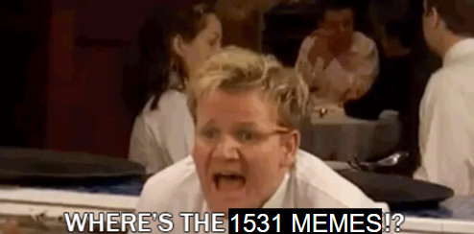
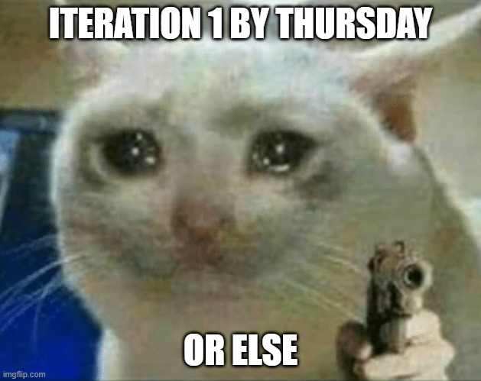
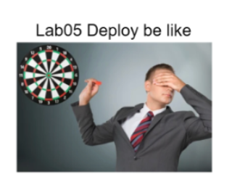
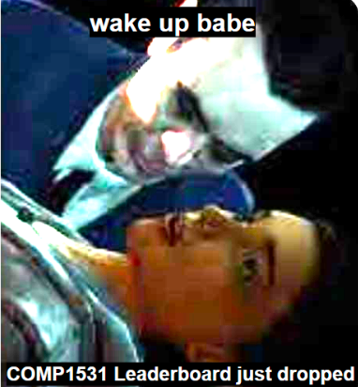
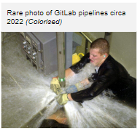
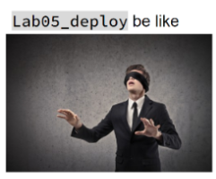
COMP1531 | T09B / H17B Week 7
2
william.huynh3@unsw.edu.au

Slide 2
Learning objectives
DRY-KISS

Slide 3
Dry Kiss

Slide 4
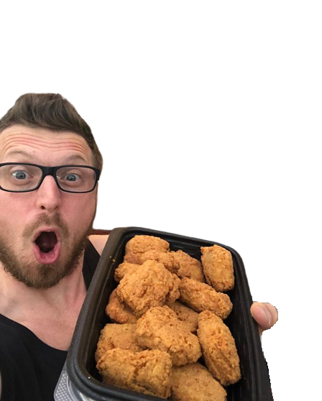
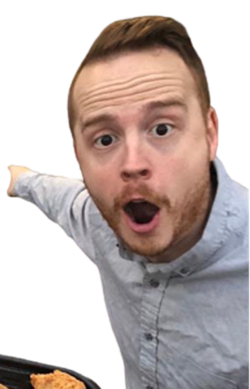
DryKiss: Writing maintainable code
DryKiss is a programming principle that stands for:
Don’t repeat yourself, Keep it Simple Stupid
It aims to reduce repetition by leveraging functions
combined with a sprinkle of common sense
DryKiss
DryKiss Principles are worth 30% of Iteration 3

Slide 5
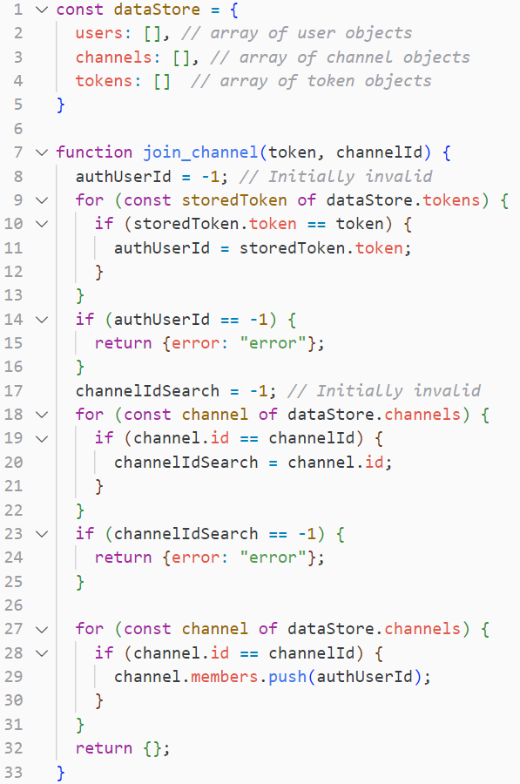
What’s wrong with this code?

Slide 6
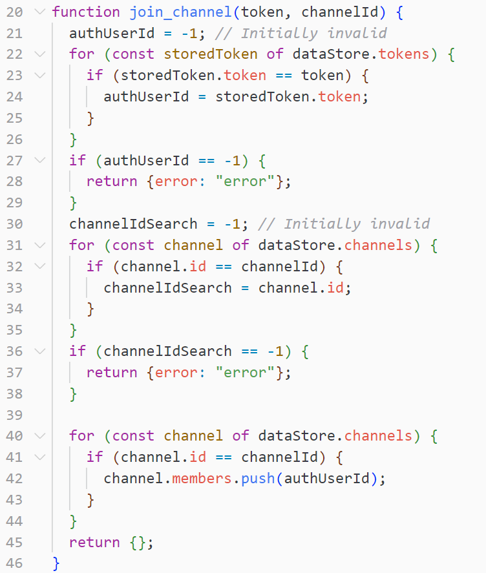
There’s a lot of repetition!
It is not simple code!!!!

Slide 7
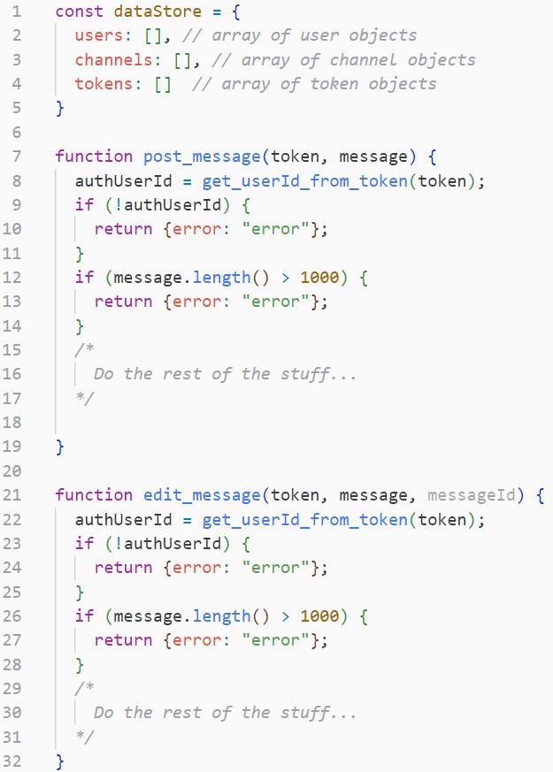
What’s wrong with this code?

Slide 8
It is not maintainable!

Slide 9
COMP1531 Week 7 - Week 10
(and COMP2511)
COMP1531 Week 1 - Week 5
Use const instead of let
Use for-of instead of for-index
Use npm packages where possible
Use in-built JS functions where possible
.includes()
.map()
.sort()
Other things from COMP1511
Good variable names
Appropriate indentation
Come back to this idiot
Following DryKiss Principles
Making use of functions wherever possible
Making code maintainable
Storing functions in appropriately named files
Regular, appropriate comments
JSDoc

Slide 10
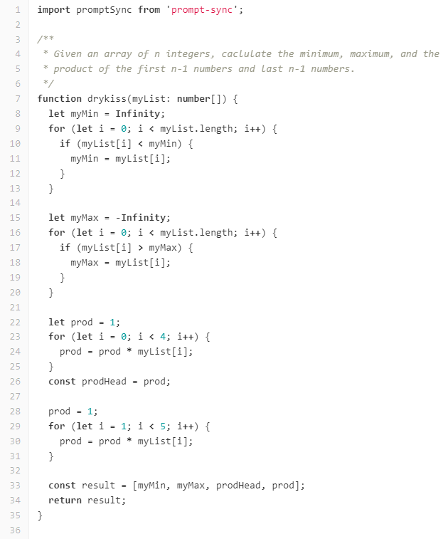
Activity
One of your teammates has written their functions for the project and made a merge request into master for their branch.
However, when reviewing their merge request, you realise that their code is of extremely poor style and does not adhere to Dry-Kiss principles at all.
Since the team-mate has “work” and cannot fix it themselves, it is up to you and the rest of your team to fix it for them!
Task: Rewrite the fool’s code to adhere to DryKiss

